Slide 1
Instructions
Duplicate template
Replace title and lines
Resize line under title – should be 0.3” height
Resize lines (18 or 16 font) and align text box to bottom of line
Add picture and send to back
Lower the picture where you want it
Crop the top
Add technology icons

Slide 2





Icons

Slide 3
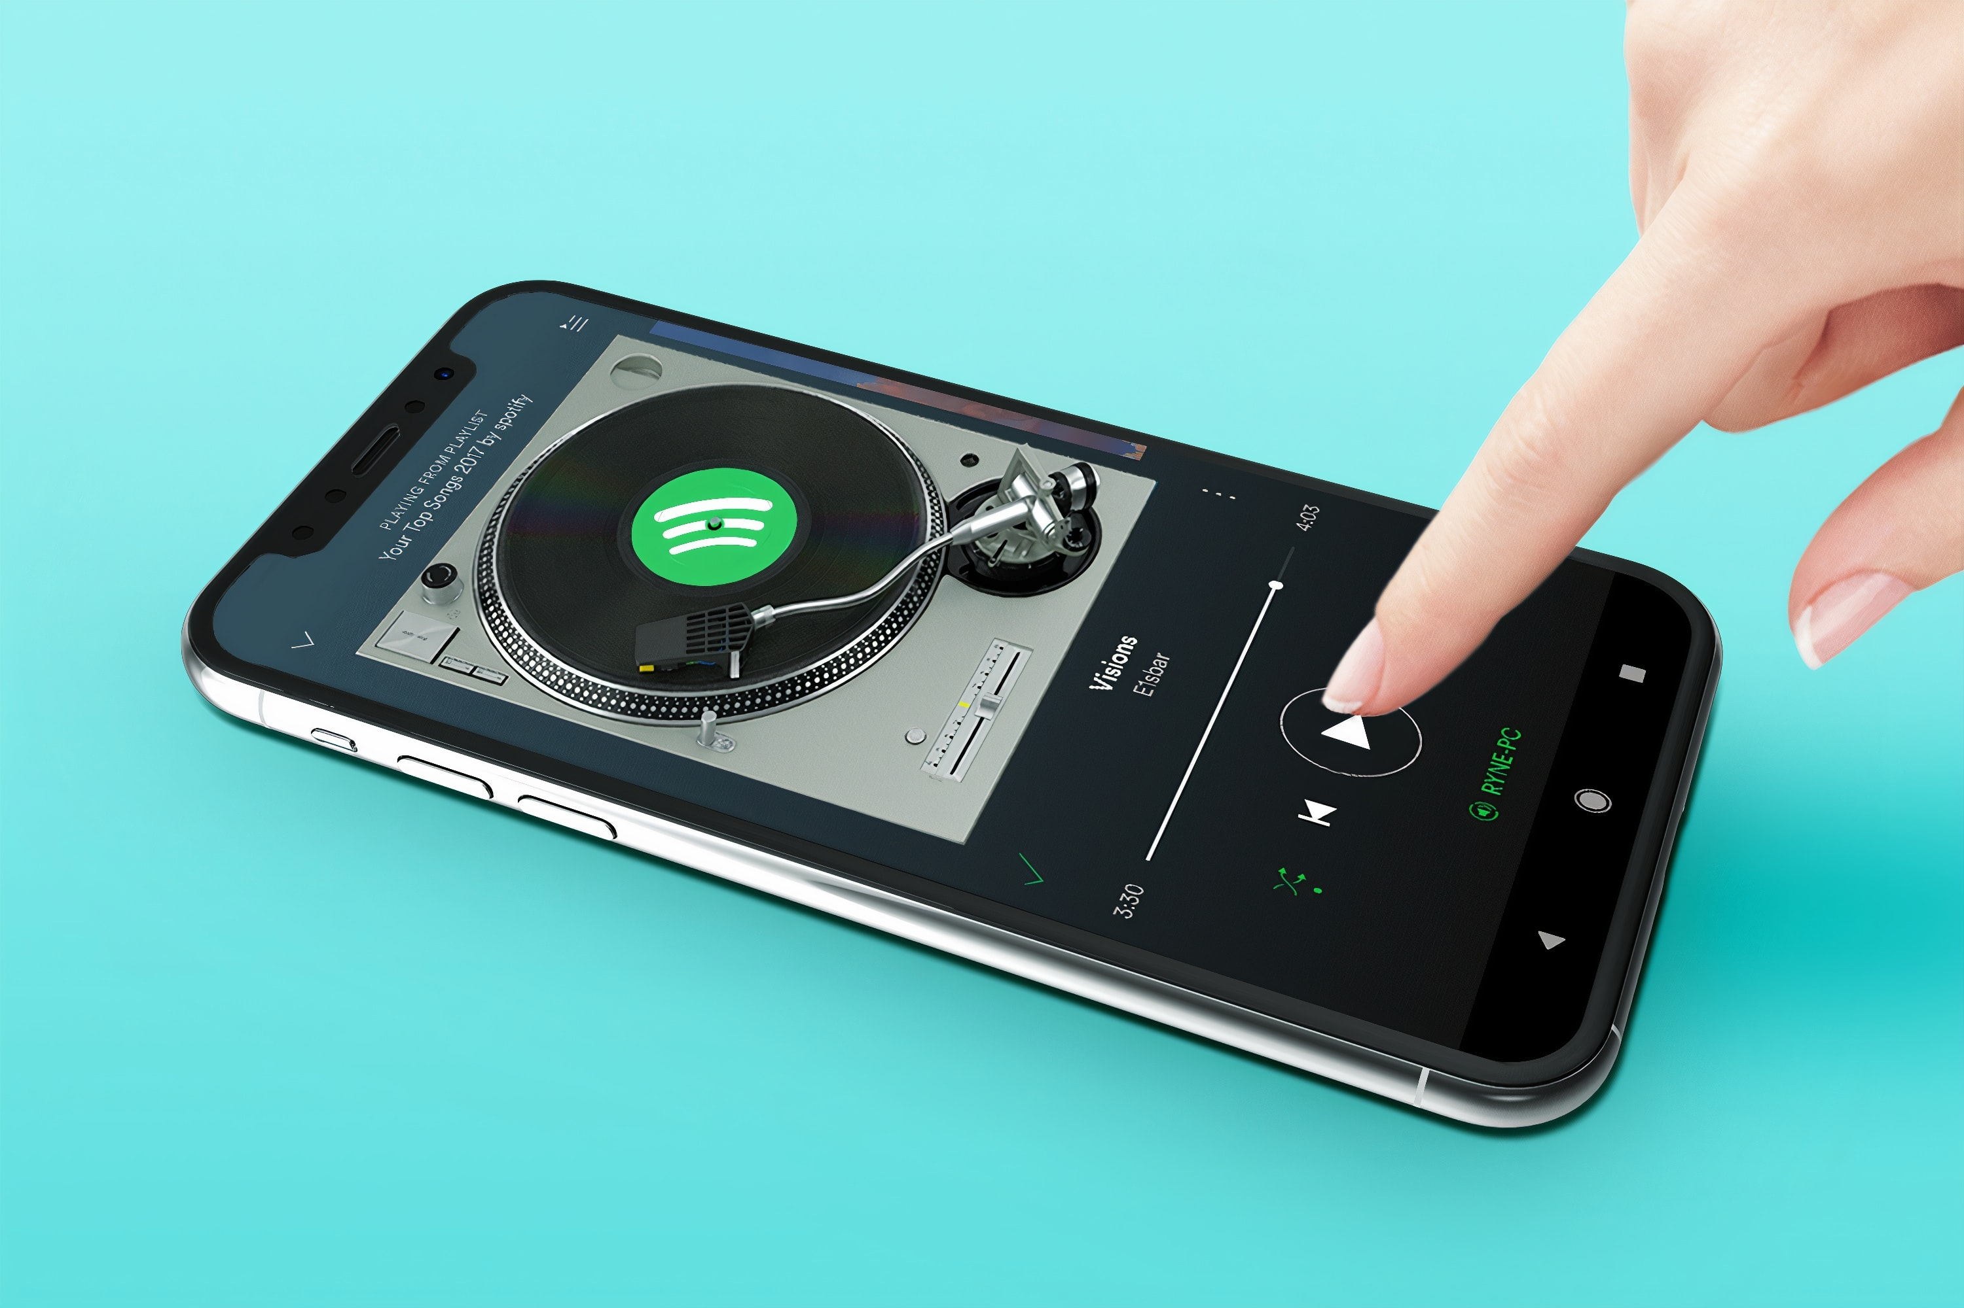
Title
Line 1 Line 2 Line 3

Slide 4

Mini-Projects
A collection of projects that explore a variety of topics on a smaller scale

Slide 5

Seattle Car Accident Data
Analyzing car accident data with MySQL for data exploration and Tableau for Visuals

Slide 6
Recommending Songs on Spotify
Using logistic regression to create a recommendation model for songs using SciKit-Learn, Pandas and SciPy through Python

Slide 7

Unsupervised Learning for Hospital Charges
Applying unsupervised algorithms to determine outliers, identify anomalous activities and provide insights for these behaviors

Slide 8

Supervised Learning for Loan Default Dataset
Applying supervised algorithms to predict loan default risk and provide insights for these behaviors

Slide 9

Model Interpretation with SHAP Values
Using SHAP values to interpret the impact of each to the model output.

Slide 10

Facial Emotion Recognition
Focuses on creating an mobile AI program that accurately recognizes the emotion from facial images.

Slide 11

Collaborative Filtering Algorithms Evaluation
Focuses on implementing, evaluating and comparing algorithms for Collaborative Filtering.

Slide 12
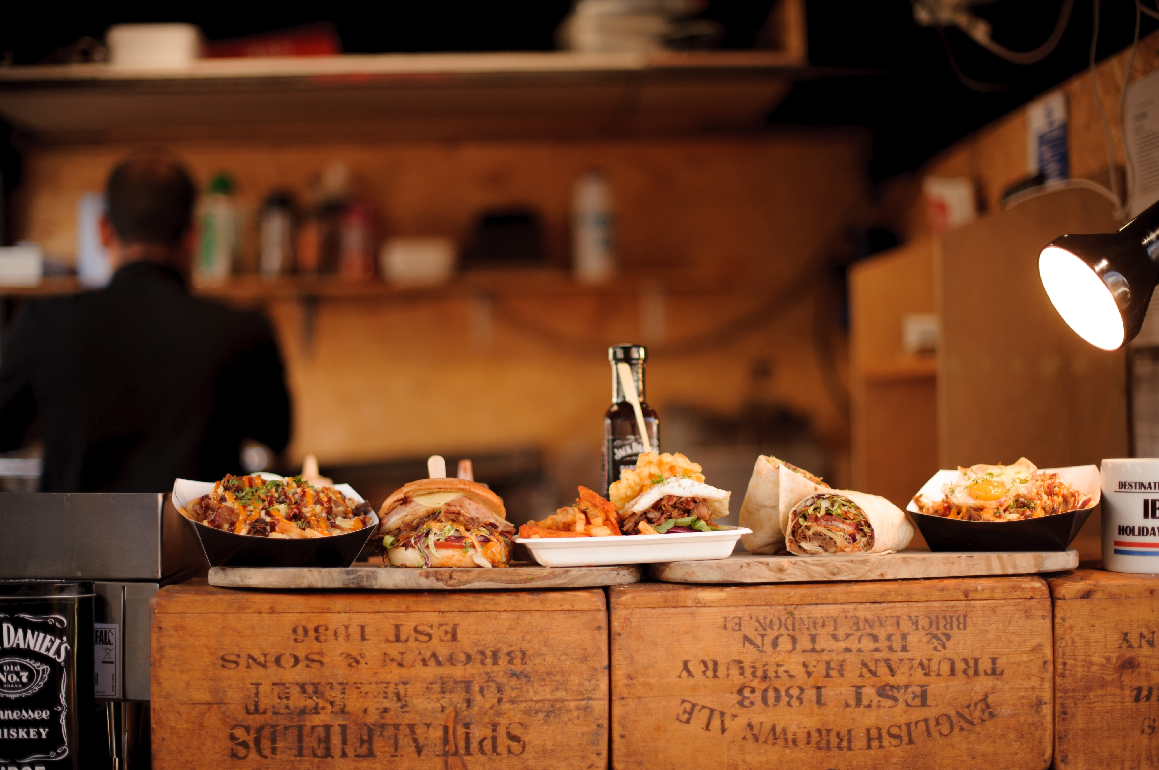
NYC Fast Food Restaurants App
A shiny app provides users with nutrition information for fast food chain restaurants in NYC.

Slide 13

Airline Industry Performance Since COVID-19
Using topics and sentiment tracking to support airlines companies for effective relaunch strategies
Used Packages: nltk, re, json, genism, numpy, scipy, sklearn, pandas, matplotlib, sumy

Slide 14

Airline Industry Performance Since COVID-19
Using topics and sentiment tracking to support airlines companies for effective relaunch strategies

